Slide 1
P7: Using the NCSTM for Statewide Project Analysis
NCMUG
April 17, 2024

Slide 2

Acknowledgements
Transportation Planning Division
Model Research and Development
Strategic Prioritization Office (SPOT)

Slide 3
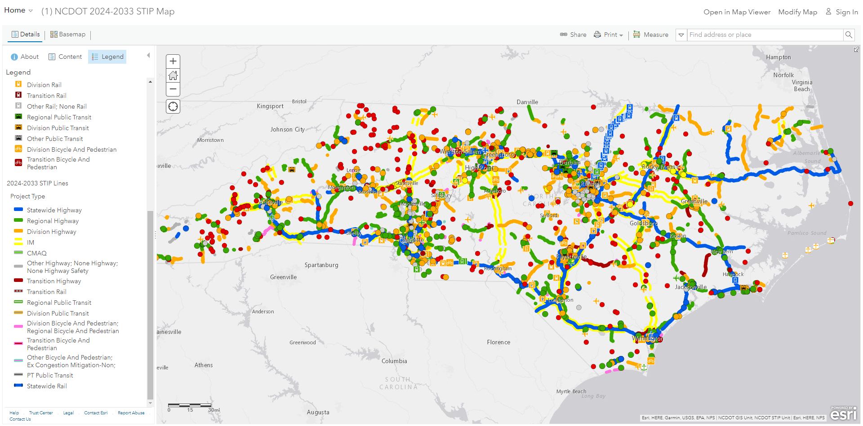
SPOT Prioritization P7
Strategic Prioritization Office (SPOT)
Prioritization process inputs to draft STIP
  Currently in prioritization 7 (P7)
Prioritize by mode
  Ferry
  Rail
  Public Transport
  Bike / Ped
  Aviation
  Highway
    Location specific capacity projects (interchange/intersection/etc.)
    Corridor-long capacity projects
We are talking about this today.

Slide 4
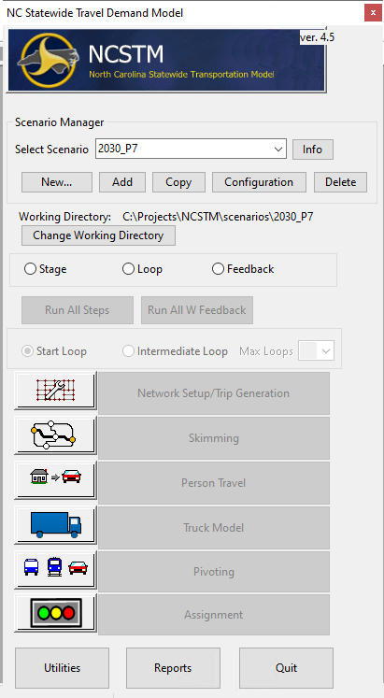
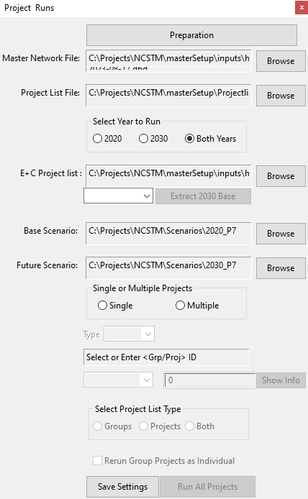
NCSTM Gen 4.5
North Carolina Statewide Transportation Model (NCSTM)
Current version: Generation 4.5
  Used in P6 and P7
2017 Base Year
Covers all of NC plus national network for LD trips
Transit sheds for mode shift, but no true transit network
Truck and passenger trips
Time of day model

Slide 5
NCSTM Gen 4.5 Methods
Ten-Year Horizon
  Modeling used 2020 and 2030 to represent base and future
Matrix Pivoting
Fixed Demand
Fixed E+C
One Project at a Time
Travel Time Savings

Slide 6
Matrix Pivoting
NCSTM Gen 4.5 includes matrix pivoting
Observed data from LBS sources (pre-COVID)
LBS data expanded to observed traffic
Matrix Pivoting is an option that applies model growth to observed matrix
Model Future
Pivoted
Better routing / more stable results
Limited sensitivity to land use changes
Most suitable to short-term horizons
Used in P7 (only 10-year horizon)
Model Base
Observed

Slide 7
Demand
Demand is generated prior to project runs
Full model is run for 2020 and 2030
Same E+C is used in both scenarios – no network changes
Resulting trip tables are used as inputs:
  For all project runs
  For 2020 and 2030 model years
Project runs are assignment-only
Fixed demand ensures that all changes between
  Build and no-build are due to the modeled project
  2020 and 2030 are due to socioeconomic growth

Slide 8
Existing + Committed
Existing = all facilities built today
Committed = all STIP projects with funding in Construction or ROW
Approximately 46 projects decommitted from P6
Some newly committed projects were also included
E+C network underwent multiple extensive reviews
Similar E+C network in some areas resulted in
  Similar travel time savings in P7 compared to P6 in most cases
  Significant travel time savings changes in other locations

Slide 9
P7 Project List
Modeled approximately 400 individual projects
Projects include carryovers from P6 and new submittals
NCSTM only used for
  Statewide Mobility and Regional Impact project categories
  Certain specific improvement types
    1 – Widen Existing Roadway
    2 – Upgrade Arterial to Freeway / Expressway
    3 – Upgrade Expressway to Freeway
    5 – Construct Roadway on New Location
    6 – Widen Existing Roadway and Construct Part on New Location
NCSTM cannot capture purely operational improvements
  Separate effort undertaken for interchanges / intersections / etc.

Slide 10
Project Coding
Projects coded using master network and project table
  Master network contains all features
    Base / E+C / Projects
  Project table includes project characteristics
    Facility type / Number of lanes / Speeds / Tolls / Etc.
  Project table is connected to network via project IDs
Brand new projects had to be coded into the network
Some older projects had to be altered to meet new limits
Some projects ran together as a group
A no-build “project” needs to be run to provide comparative outputs
Projects ran in tranches of 10 over 3 machines across 2 states

Slide 11
Travel Time Savings
NCSTM analyzes trips using the project links
Select link is used to trace project trips along the network
  Returns the origin and destination TAZs for users of the project
Model calculates project VHT from the trip tables and congested skims for project ODs
  Base and Future Year
  Build and No Build
  Auto and Truck
Results are written to CSV and placed in spreadsheet
Spreadsheet calculates VHT differences and reports as savings

Slide 12
Results
UNDER REVIEW – DRAFT – NOT FINAL

Slide 13
P7 Schedule https://connect.ncdot.gov/projects/planning/Pages/PrioritizationResources.aspx
November 2023 - April 2024
  Data review and scoring (to include partner data review)
May 1, 2024
  Deadline for SPOT Office approval of all Local Input Point assignment methodologies
End of May 2024
  Quantitative Scores and Statewide Mobility Programmed Projects Released
June - August 2024
  Regional Impact Local Input Point assignment window
End of September 2024
  Regional Impact Total Scores and Programmed Projects Released
October - December 2024
  Division Needs Local Input Point assignment window
March 2025
  Draft 2026-2035 STIP released (final adoption in Fall 2025)

Slide 14
Questions?
Thank you!!!

